Slide 1
Phonepe Transactions Insights
A Data-Driven Analysis of Digital Payment Trends
Presented By : Gowtham

Slide 2
Agenda
Project Overview
Dataset & Scope
Visualization Highlights
Insight & Observations
Technical Highlights
Conclusion

Slide 3


Phonepe Transactions
This project aims to analyze and visualize aggregated values of payment categories

Slide 4
Project Overview
Objective
Analyze PhonePe transaction data to extract meaningful and actionable insights.
Technology Used
Python, SQL, Json, Streamlit, Pandas, babel, sqlalchemy, dotenv, urllib
Data Source
PhonePe Open Data Github Repository
Key Functions
ETL processing of raw transaction/user data
Visualizaton of state-wise, category-wise, and time-based trends
Interactive dashboard creation using Streamlit and Plotly

Slide 5
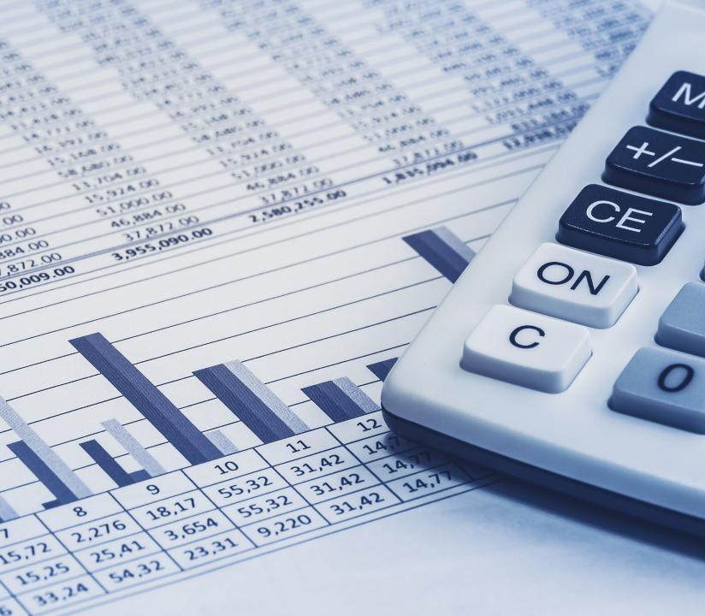
Dataset & Scope
Collecting the data from the official data source provider and visualize the growth patterns over the year and quarters

Slide 6
Dataset & Scope
Data Categories
Transaction
Insurance
User
Sources
Scope
Data from phonepe pulse github repository
Analyze the transaction , identify the growth patterns and build an interactive Streamlit dashboard
Structure
File Format
Year and Quarter wise data
State and District level data
JSON File format
JSON File format

Slide 7
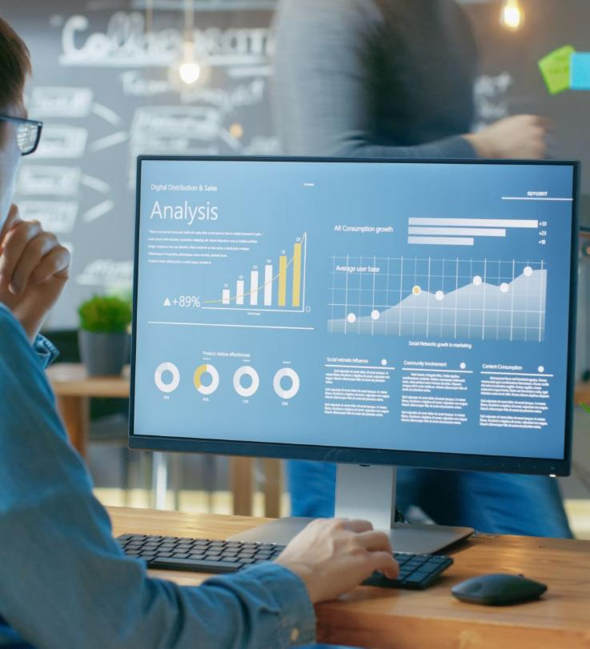
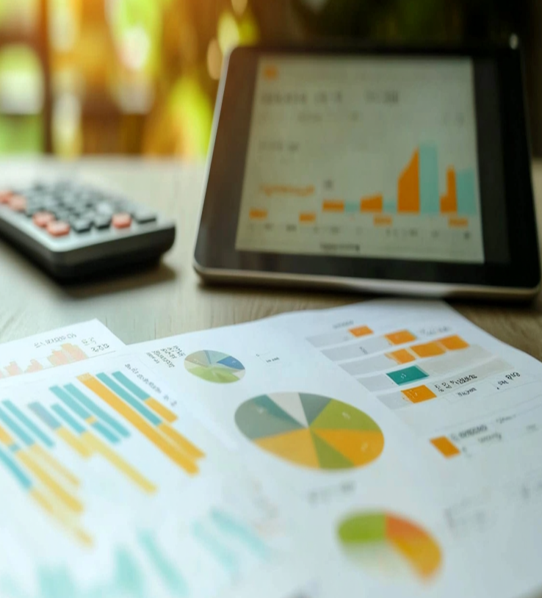
Visualization Highlights
Understanding the transaction growth, comparison and distribution

Slide 8
Visualization Highlights
Visualized total transaction volume growth
Bar chart showing top-performing states and table display the top 10 transactions
Pie chart showing the category wise transaction percentage
Provide the filter option to filter the records, Year , Quarter and State wise transactions

Slide 9

Insights & Observations
Digital transactions growth, insurance analysis, major activity to register the application in urban and metro regions and UPI adoption in the smaller cities

Slide 10
Insights & Observations
Digital payments show steady growth across all regions
Gather the Top-performing states
Mobile recharges and peer-to-peer transfers are the most used services
Tier-2 and Tier-3 cities are rapidly adopting UPI-based payment systems
Pin code level analysis reveals local hotspots of high user engagement
Insurance and utility payments gaining details

Slide 11


Technical Highlights
Discuss about the data sourcing, used libraries and visualization tool

Slide 12
Technical Highlights
Data Source - PhonePe Pulse GitHub JSON format
Data Handling: Cleaned, transformed, and aggregated using Python (Pandas)
Visualization: Created dynamic charts with Plotly and Matplotlib
Mapping: State and district-level maps generated using GeoJSON and Plotly
Dashboard: Built an interactive Streamlit web app for user-driven analysis
Filters: Enabled selection by year, quarter and state.

Slide 13

Conclusion
Analyzed the PhonePe transaction trends across regions,
Highlighted top states, districts, and services and built interactive visualizations for deeper insights

Slide 14
Conclusion
The project successfully analyzed PhonePe transaction trends across India
Identified top-performing regions and most-used services
Created interactive visualizations for detailed exploration
Observed growth in digital payments, insurance and user registration
Provided Insights useful for business

Slide 15
Thank You

